Slide 1
Cocaine Anonymous
Public Service Announcement

Slide 2
Cocaine Anonymous
Message to the Professionals
“The Truth from the False”
12 Step Recovery
What it is
What it isn’t
How it works

Slide 3
Cocaine Anonymous Can Help
Many misconceptions about 12-Step recovery persist despite thousands of lives transformed.
These misconceptions may present an obstacle to the professional when developing or mandating a recovery curriculum.
We hope to demonstrate the value of a 12-Step program for the participant who is motivated to recover from addiction.
Our goal is to bring clarity where there may be confusion for the professional who seeks to provide structure and treatment for their offenders.

Slide 4
What is Cocaine Anonymous?
Cocaine Anonymous (C.A.) is a fellowship of men and women who share their experience, strength and hope with each other so that they may solve their common problem and help others to recover from their addiction.
Cocaine Anonymous practices a 12-Step program for daily recovery that has worked for many thousands worldwide.
Cocaine Anonymous is an abstinence-based recovery program.
German
| Welsh
| Portuguese | Danish
| Farsi |
Russian
| Spanish | Swedish | French | English

Slide 5
Who can attend Cocaine Anonymous?

Slide 6
Who can attend Cocaine Anonymous?
The only requirement for membership is a desire to stop
using cocaine and all other mind-altering substances.
Anyone with a drug or alcohol problem can attend any C.A. meeting.
You, as a professional, are welcome to attend our open meetings.
For meeting information and locations visit: www.CA.org

Slide 7
How Cocaine Anonymous Works
There is no professional class of help or therapy. All service
provided by C.A. members is voluntary.
Meetings are held on a regular basis to facilitate a fellowship of recovered men and women who help newcomers find a solution to their addiction.
Cocaine Anonymous is a program of action—sober addicts, freely helping other addicts through sponsorship by taking them through the 12 Steps of Recovery.
Sponsors act as mentors and guides through the 12 Steps. They are addicts, who, being recovered from their addiction, freely pass on their experience of 12 Step recovery to the addict who still suffers.

Slide 8
There are No Fees to Pay
Cocaine Anonymous is FREE. Each C.A. Group is a fully self-supporting entity.
Expenses are covered by the voluntary contributions of our members, literature sales, and fundraising events such as conventions.
C.A. respectfully declines donations and financial contributions from any outside source.
Cocaine Anonymous World Services receives voluntary contributions from its Areas and Groups.
The money is used to inform the general public and professional communities about Cocaine Anonymous, and to carry our message to the still suffering addict.

Slide 9
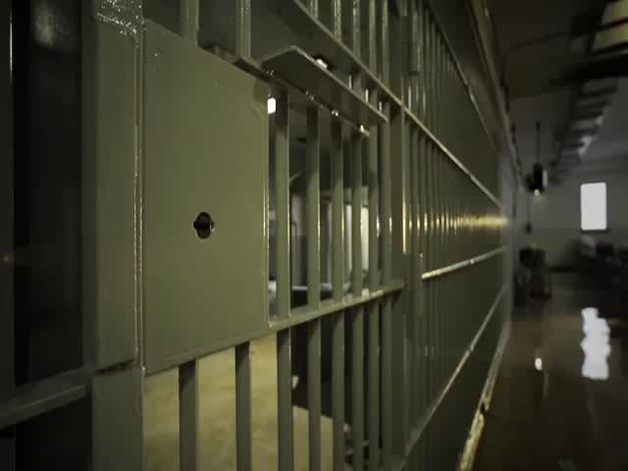
Public Service Announcement

Slide 10
Cocaine Anonymous Can Help
Public Information – Cocaine Anonymous provides a wide range of media, including literature, posters, PSAs (print, radio, and TV) and informative presentations in cooperation with local and national media and other organizations to spread the message that recovery is possible.
Telephone Helpline – Our telephone helplines are available to anyone looking for help or information. The helpline provides initial contact between the using addict and a Cocaine Anonymous member.
Health – Cocaine Anonymous can provide a variety of materials for GPs, hospital and treatment center staff and individuals who work with people who have substance abuse problems.

Slide 11
Resources Available to the Professional
Presentations to your organization
C.A. Members to speak to your staff or clients
Educational and informational literature
Our Lifeline Program– connecting your offenders with C.A. meetings in your local community.

Slide 12
Hospitals & Institutions (H&I)
The purpose of a Hospitals and Institutions Committee is to carry the message of Cocaine Anonymous to those in Hospitals and Institutions.
These meetings are brought into facilities by local C.A. members virtually or in-person.
Institutions such as correctional facilities, juvenile detention centers, half-way houses, detoxification units, homeless shelters, and sanitariums, either governmental or private.
Confinement may be voluntary or mandated.
C.A. H&I meetings are held at the invitation of the Hospital or Institution, ever mindful of the admonition "Cooperation, not Affiliation"

Slide 13
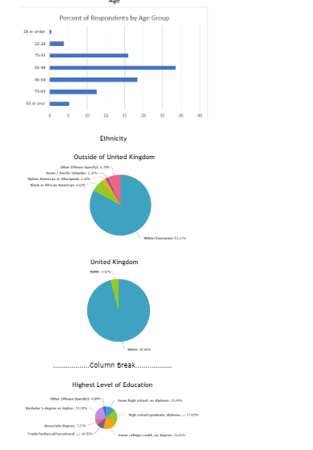
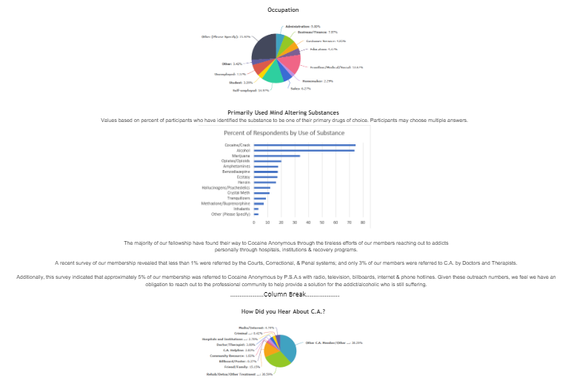
Fact File

Slide 14
We Are Passionate About Recovery!
C.A. is growing rapidly around the world. There are
thousands of meetings every week.
This growth is driven by the altruistic idea that lives at the heart of 12-Step Recovery: One addict/alcoholic working with another to share a common solution to their common problem.
When we work together and cooperate with each other, long term recovery can become a reality throughout our communities.

Slide 15
What Cocaine Anonymous is Not
Cocaine Anonymous is NOT a Cult or Religion.
Cocaine Anonymous is NOT a Drug-specific program.
Cocaine Anonymous is NOT the only solution for drug addiction. We have only found a way that works for us.

Slide 16
What Cocaine Anonymous Is
Cocaine Anonymous is an inclusive program that offers a solution to recover from any and all mind-altering substances.
Cocaine Anonymous is a spiritual program of recovery.
Cocaine Anonymous has no affiliation with any sect, denomination, politics, organization, or institution.
Cocaine Anonymous has no fees or dues for membership; we are fully self-supporting through our own voluntary contributions.
We’re Here and We’re Free
TM

Slide 17
…and all other mind altering substances
Cocaine Anonymous

